Slide 1
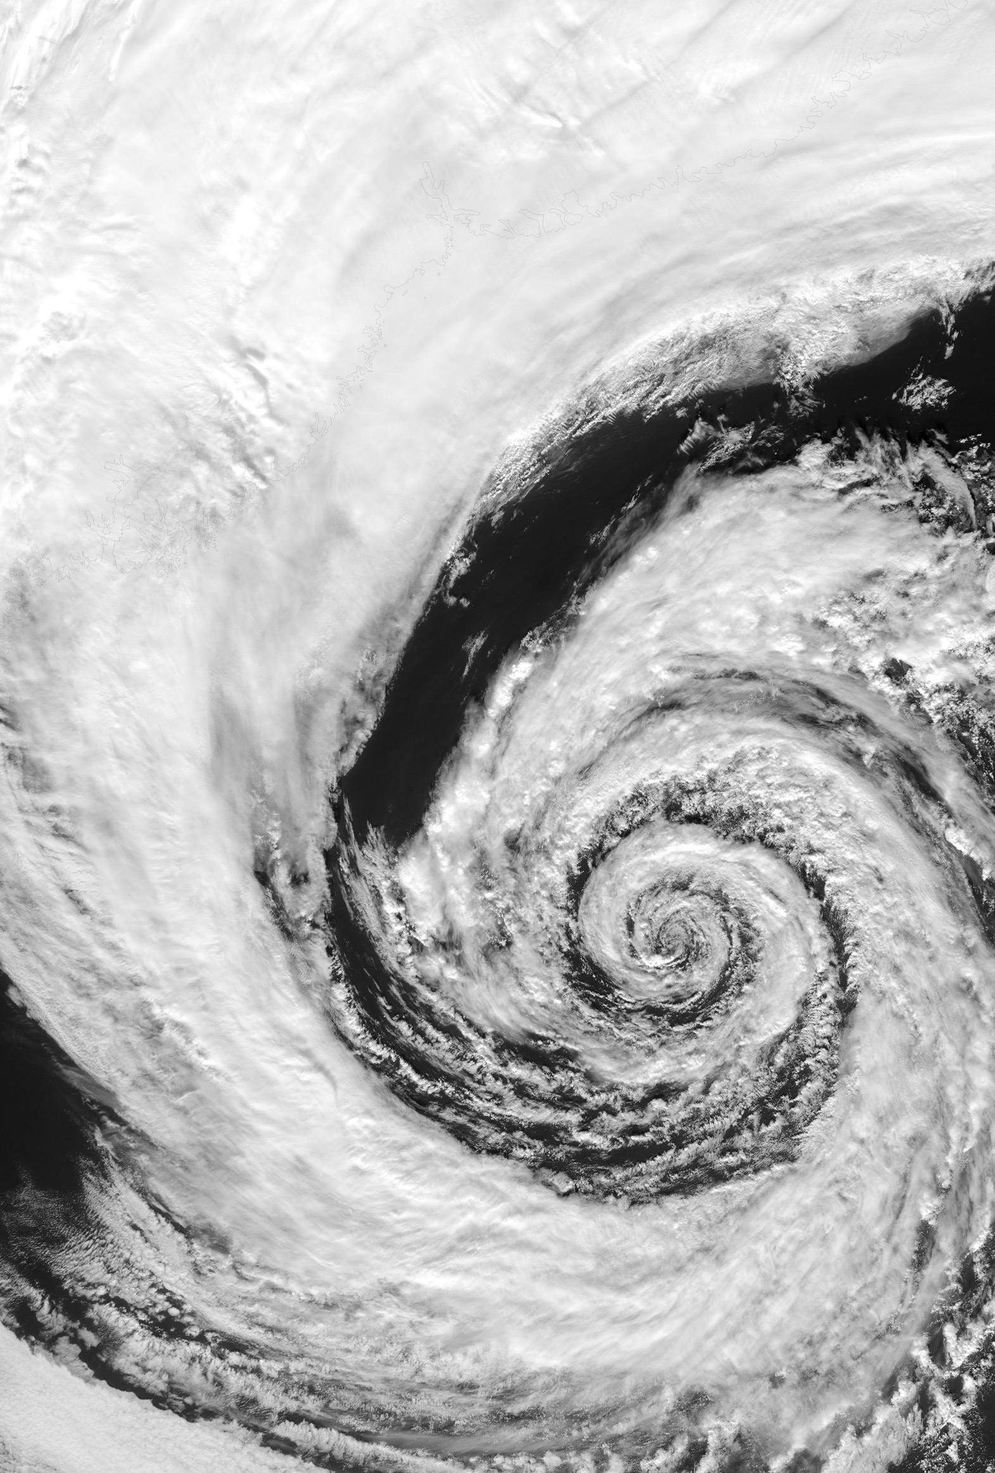
Universal Patterns of Design Dynamics
Željko Obrenović
Erik Stolterman

Slide 2
Design
Instability
Notes on Design Complexity
Željko Obrenović
Erik Stolterman

